Slide 1
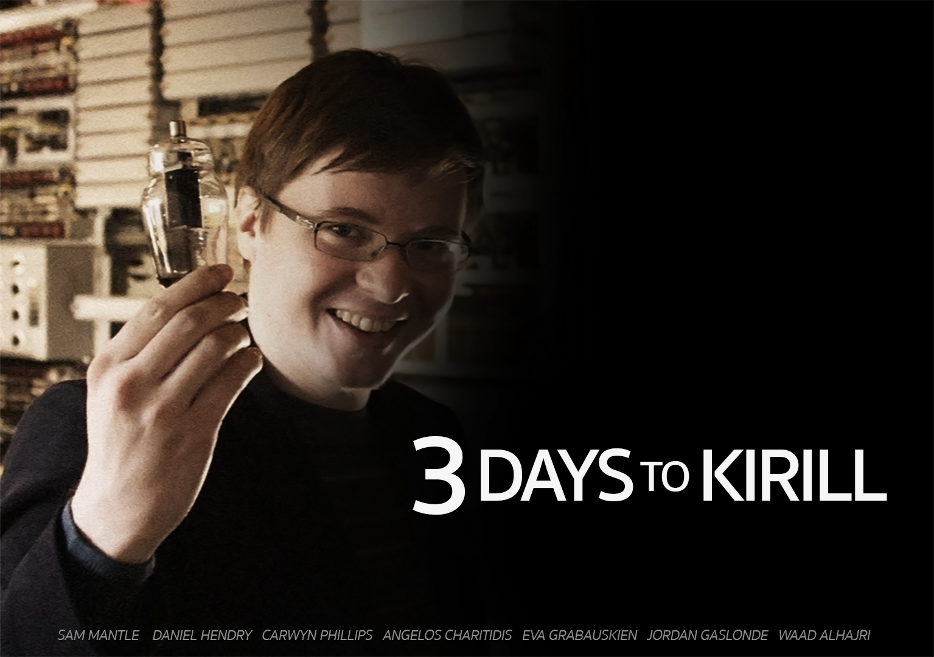
Customers of RetroBazinga Ltd.

Slide 2

What is ‘3 Days to Kirill?
Text based adventure/puzzle game
Runs on any PC with python 3.4+
Story’s map based around Cardiff area
You play against multiple constraints
Find items to achieve your objective
Sustain health and hunger
Remember what rooms to avoid
Notes:
Eva

Slide 3
Audience
Customers of RetroBazinga
Ages 13+
Fun for anyone who enjoys text-based games
Appeals to anybody who enjoys adventure & puzzle games (even if they’re not familiar with text based games)
Notes:
Waad

Slide 4
Story & Objective
Your university lecturer has been arrested.
You need to break him out of prison in exchange for a high grade.
You have 72 hours to break him out, or else you fail the game.
Time will decrease after every move you take.
During that time you must travel across rooms to find the keys and items necessary to break him out of prison.
If you go to prison without ALL the items, you fail and must start over.
You also need a guards uniform in order to get in successfully.
During your travels you must sustain your health and hunger by eating food you buy from certain rooms.
If your hunger gets too low, your health decreases until you eat. If you don’t, you die.
Avoid the bad rooms as much as you can, they inflict damage and decrease your health.
You have the choice to break him out of prison.
Notes:
Sam

Slide 5
Features of the game
Users can choose their own player name
Start central to the map (Student Union)
One way and bidirectional paths to the rooms
17 Rooms
Start at the Student Union
3 Key rooms (2 keys and 1 weapon)
3 Food rooms
4 Bad rooms (Will damage your health)
8 Normal rooms
Prison (final room)
Notes:
Carwyn

Slide 6
Features of the game
Notes:
Carwyn

Slide 7
Features of the game
Multiple food items can be bought from 3 shops in the map (Starbucks, Café and The Taff).
You could steal them… however you end up in prison alongside Kirill and your items are taken away.
Timer (starts on 72 hours).
Player Health decreases when hunger reaches 0.
Need 3 items to break Kirill out of prison.
Notes:
Jordan

Slide 8
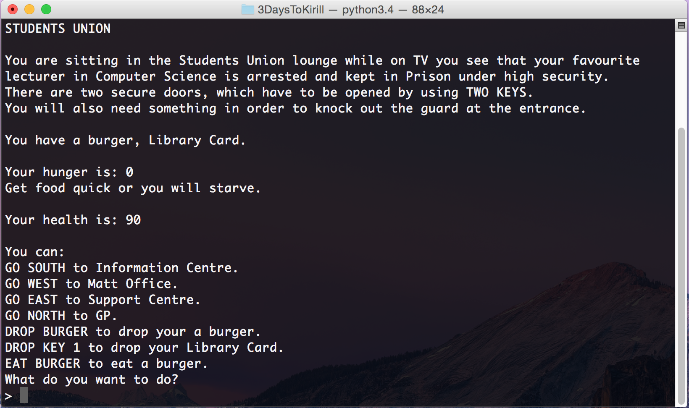
Live Demonstration
Notes:
Dans

Slide 9

The Future
Online Score Board to show your friends via social media
More features may include
More maps to chose from (different areas)
New rooms
More Difficulty Settings
Longer storyline & Side missions
Support for mobile platforms
Notes:
Sam

Slide 10
Reviews
“I don’t have a social life, but now I don’t even need one.”
- Anonymous Gamer
“Kirill is the new Charles Bronson.”
- Python Gamers Magazine
“It’s like a roulette; Fun until it gets Russian.” - Anonymous Gamer
“The moment I started playing this game. I quit my job.”
- Prince Harry
“I can’t win this game!!!” -Dr. Mad Morgan
Notes:
Angelos

Slide 11
Questions?
?
Notes:
Jordan

